Slide 1


Social Buzz

Slide 2


Today's agenda
Project recap
Problem
The Analytics team
Process
Insights
Summary

Slide 3

M
Social Buzz is a fast growing technology unicorn that need to adapt quickly to it’s global scale.
Accenture has begun a 3 month POC focusing on these tasks.
An audit of Social Buzz’s big data practice.
Recommendations for a successful IPO.
Analysis to find Social Buzz’s top 5 most popular categories of content.
Project Recap

Slide 4

Problem
Over 100,000 pieces of content each day
Data is highly unstructured.

Slide 5



Manav Sathi
Data analyst
The
Analytics team
Marcus Rompton
Senior Principle
Andrew Fleming
Chief Technical Architect

Slide 6
Process
1
Data understanding
2
Data Cleaning
3
Data Modeling
4
Data Analysis
5
Uncover Insights

Slide 7

Insights
16
UNIQUE
CATEGORIES
1897
REACTIONS TO “ANIMALS” POSTS
JANUARY
MONTHS WITH MOST POSTS

Slide 8
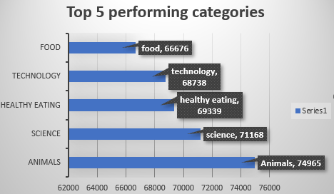

Slide 9
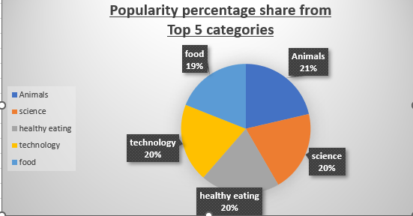

Slide 10

ANALYSIS
Animals and science are the two most popular categories of content, showing that people enjoy “real-life” and “factual” content the most.
INSIGHT
Food is a common theme with the top 5 categories with “Healthy Eating” ranking the highest. This may give an indication to the audience within your user base. You could use the insight to create a campaign and work with healthy eating brands to boost user engagement.
NEXT STEPS
This ad-hoc analysis is insightful, but its time to take this analysis into large scale production for real-time understanding of your business. We can show you how to do this.
Summary

Slide 11
Thank you!
ANY QUESTIONS?

